Slide 1
TEACHER’S PERSONAL INFORMATION
Name: Nguyen Thanh Loan
Facebook: Loan Nguyễn Thanh
Mobile number: 0942 255 937
Email: loannguyenthanh1978@gmail.com
Zalo lớp: DH20LT – TA1A - 010112283741

Slide 2
ONLINE ASSIGNMENTS
https://www.helbling-ezone.com
Course: ………………….
Course ID: ………………….

Slide 3
UNIT 2
FAMILY AND HOME
LESSON 3
Where’s the bank?

Slide 4
CONTENTS
Vocabulary: places in town, prepositions of places, large numbers, people, physical appearance, personality
Listening: population statistics.
Speaking: talking about places and population
Writing: a description of a place

Slide 5
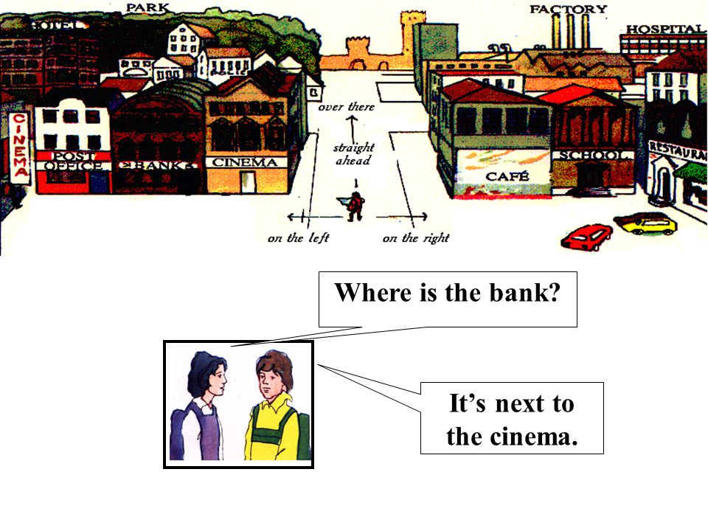
Lesson 3
Where’s the bank?

Slide 6
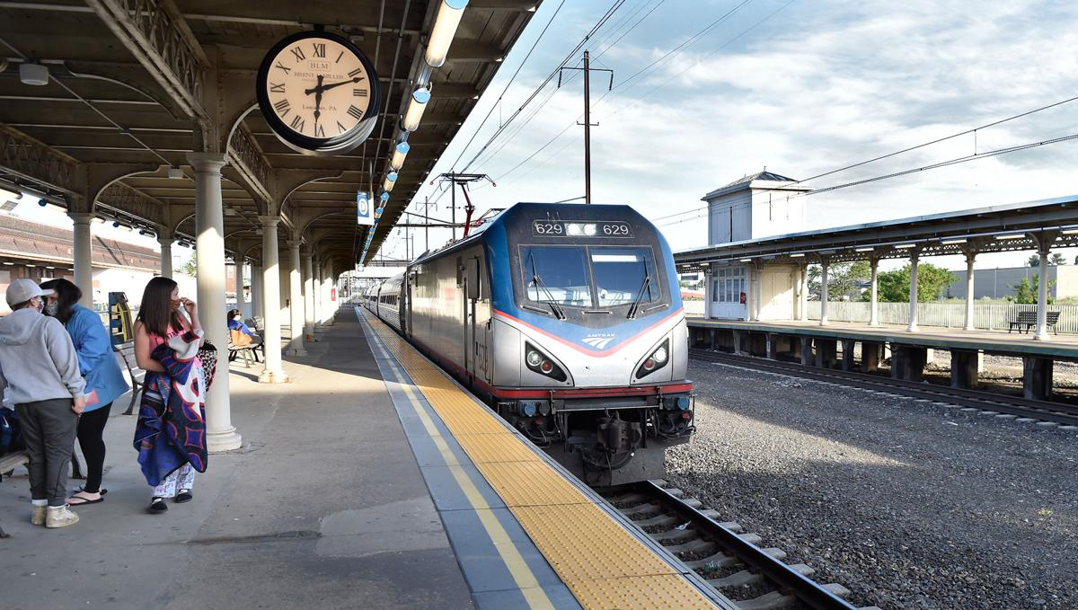
VOCABULARY
Places in town
train station
/treɪn ˈsteɪʃn/

Slide 7
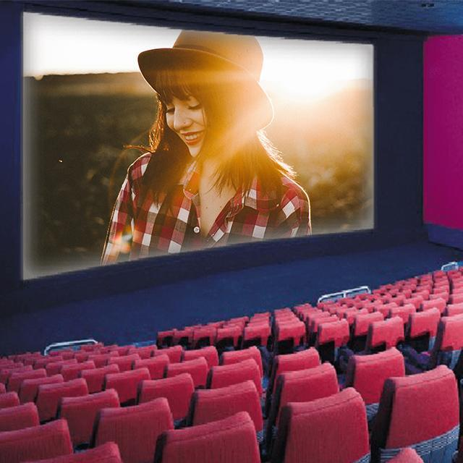
VOCABULARY
Places in town
Movie theater
/ˈmuːvi θɪətə(r)/
a building in which films are shown

Slide 8
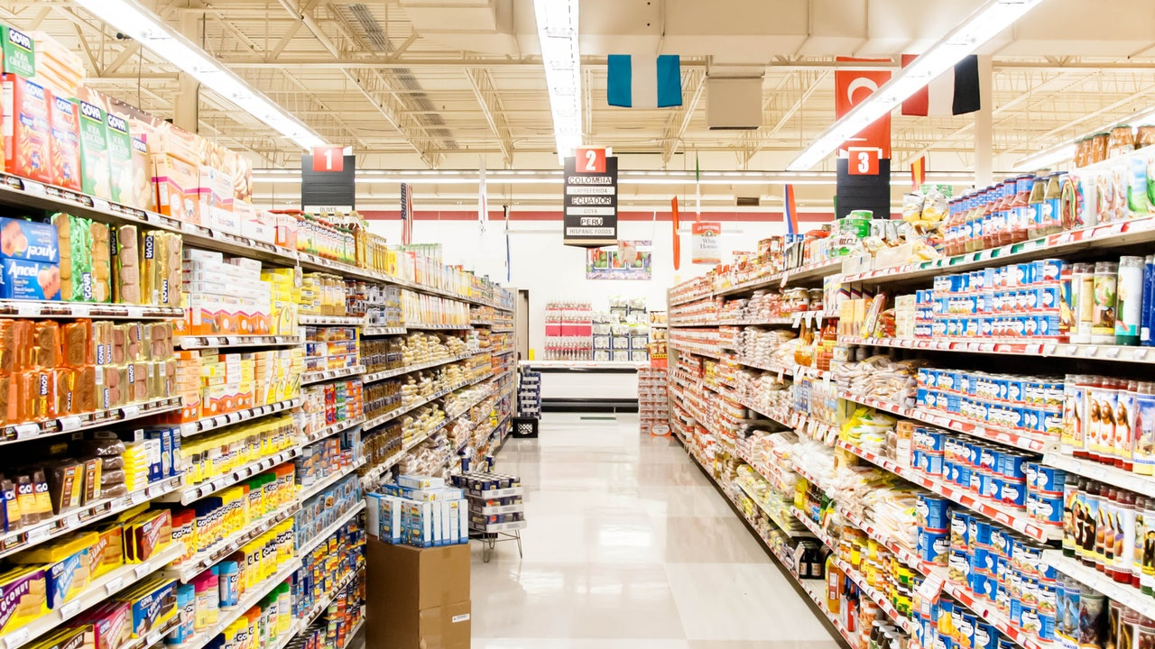
VOCABULARY
Places in town
supermarket
/ˈsuːpəmɑːkɪt/
a large shop that sells food, drinks and goods used in the home. People choose what they want from the shelves and pay for it as they leave.

Slide 9
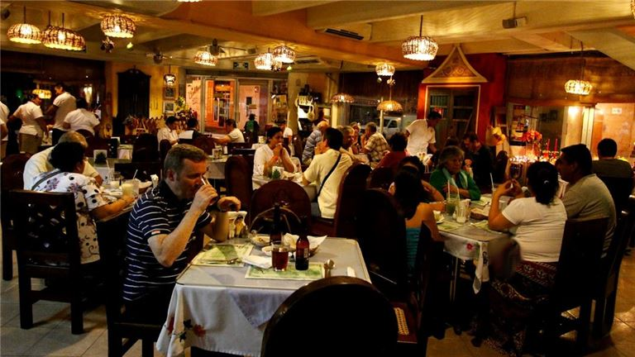
VOCABULARY
Places in town
restaurant
/ˈrestrɒnt/
a place where you can buy and eat a meal

Slide 10

VOCABULARY
Places in town
Drugstore
/ˈdrʌɡstɔː(r)/
a shop that sells medicines and also other types of goods, for example cosmetics

Slide 11
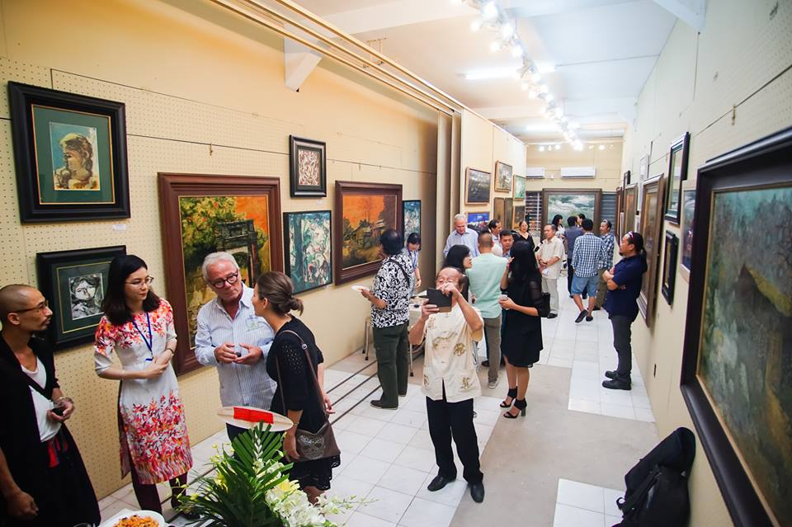
VOCABULARY
Places in town
Art gallery
/ˈɑːt ɡæləri/
a building where paintings and other works of art are shown to the public

Slide 12
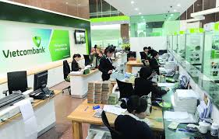
VOCABULARY
Places in town
bank
/bæŋk/
an organization that provides various financial services, for example keeping or lending money

Slide 13
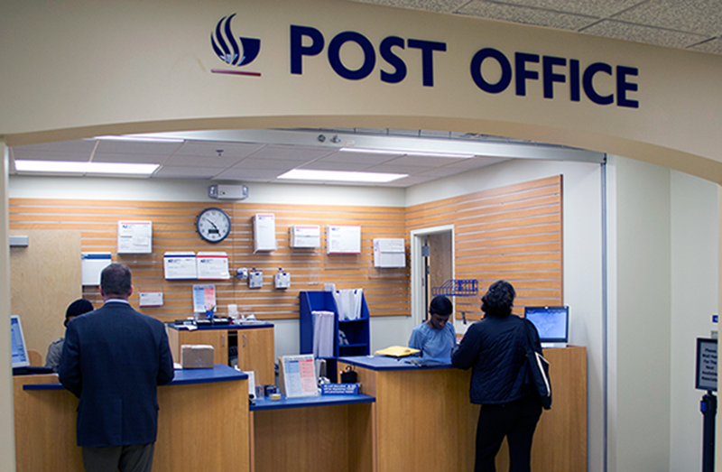
VOCABULARY
Places in town
Post office
/ˈpəʊst ɒfɪs/
a place where you can buy stamps, send letters, etc

Slide 14
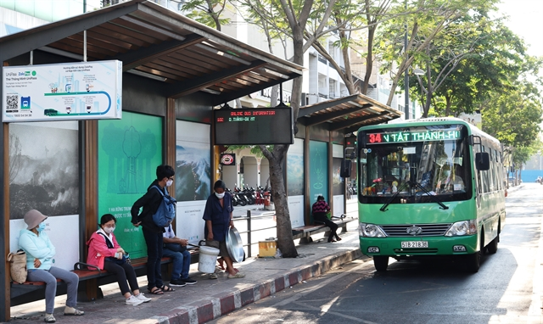
VOCABULARY
Places in town
Bus stop
/ˈbʌs stɒp/
a place at the side of a road that is marked with a sign, where buses stop

Slide 15
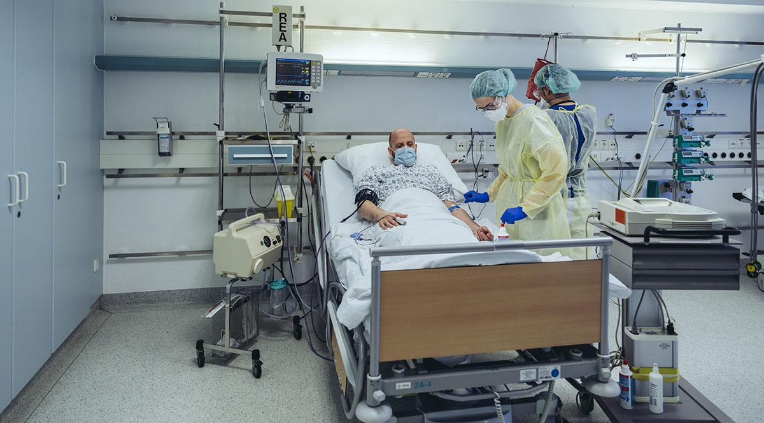
VOCABULARY
Places in town
hospital
/ˈhɒspɪtl/
a large building where people who are ill or injured are given medical treatment and care

Slide 16
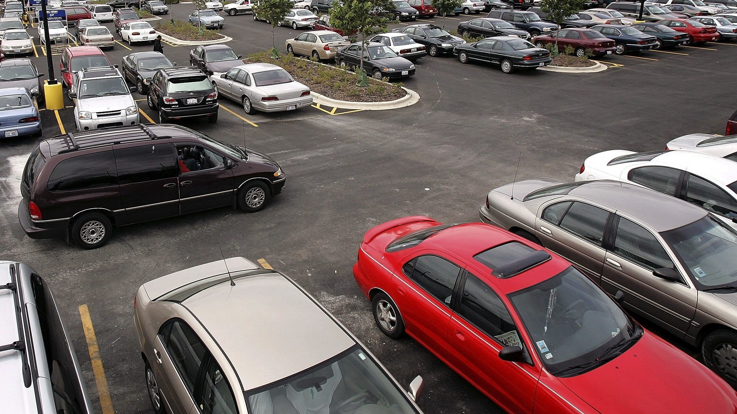
VOCABULARY
Places in town
Parking lot
/ˈpɑːkɪŋ lɒt/
an area where people can leave their cars

Slide 17
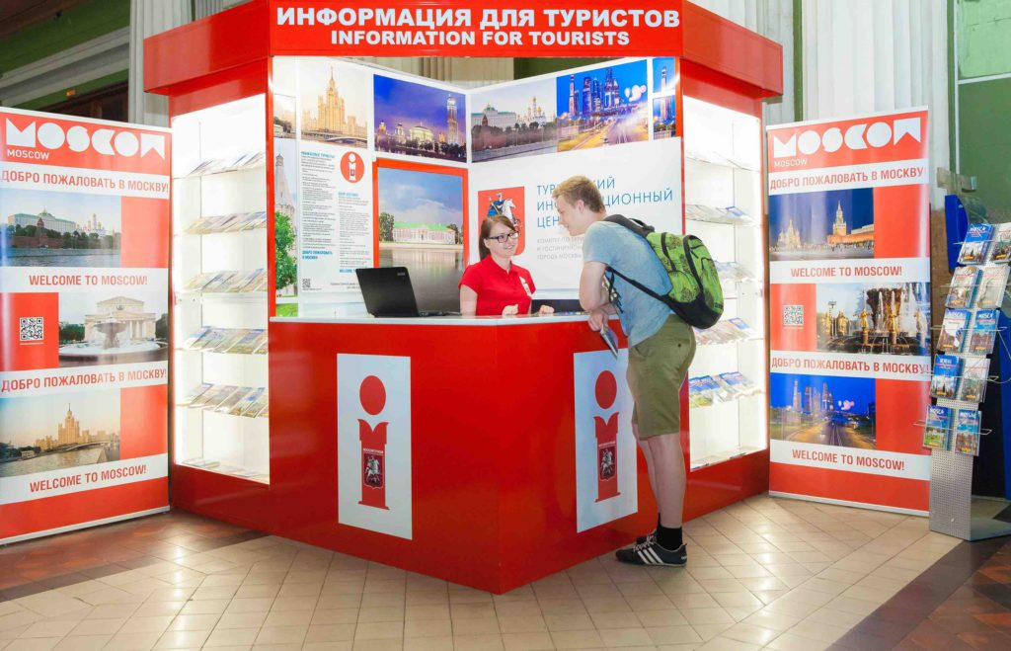
VOCABULARY
Places in town
Tourist information (office)
/ˌtʊərɪst ˌɪnfəˈmeɪʃn ɒfɪs/
an office in many towns and cities where tourists can get information on interesting things to see and do in the local area, help with finding somewhere to stay, and advice on travel. Tourist offices often also sell postcards, souvenirs, etc.

Slide 18
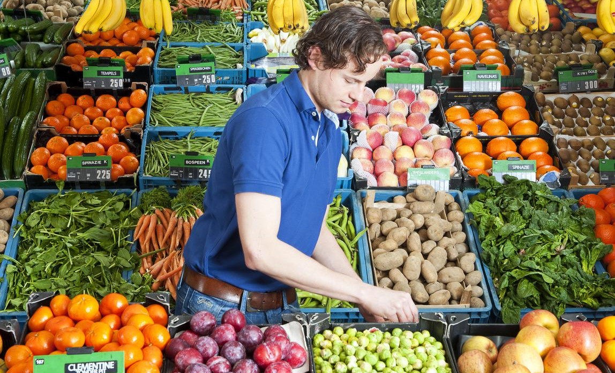
VOCABULARY
Places in town
Greengrocer’s
/ˈɡriːnɡrəʊsə(r)/

Slide 19

VOCABULARY
Places in town
florist’s
/ˈflɒrɪst/
a shop that sells flowers and plants

Slide 20
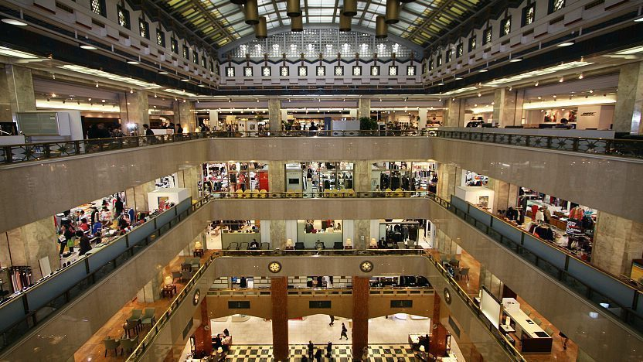
VOCABULARY
Places in town
Department store
/dɪˈpɑːtmənt stɔː(r)/
​a large shop that is divided into several parts, each part selling a different type of goods

Slide 21
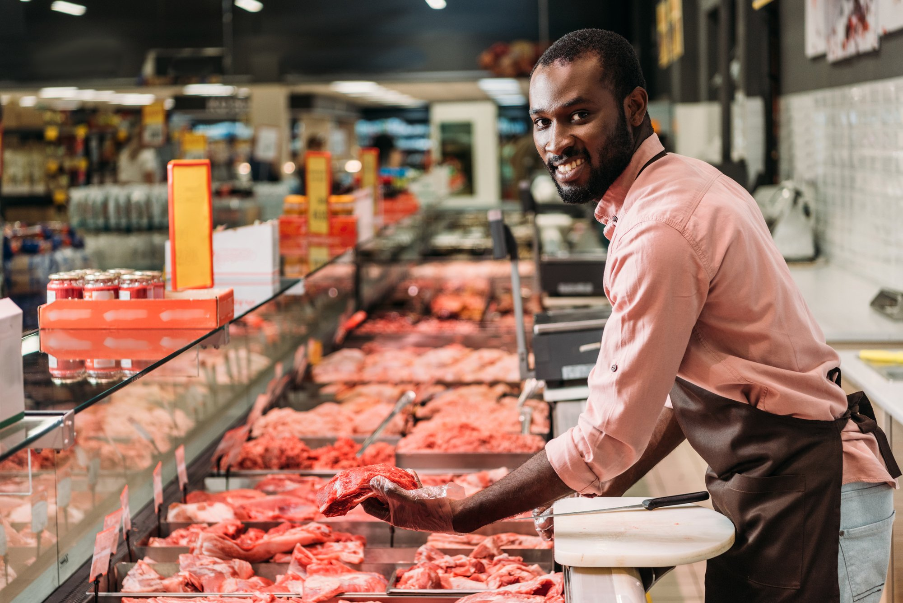
VOCABULARY
Places in town
butcher’s
/ˈbʊtʃə(r)/
a shop that sells meat

Slide 22
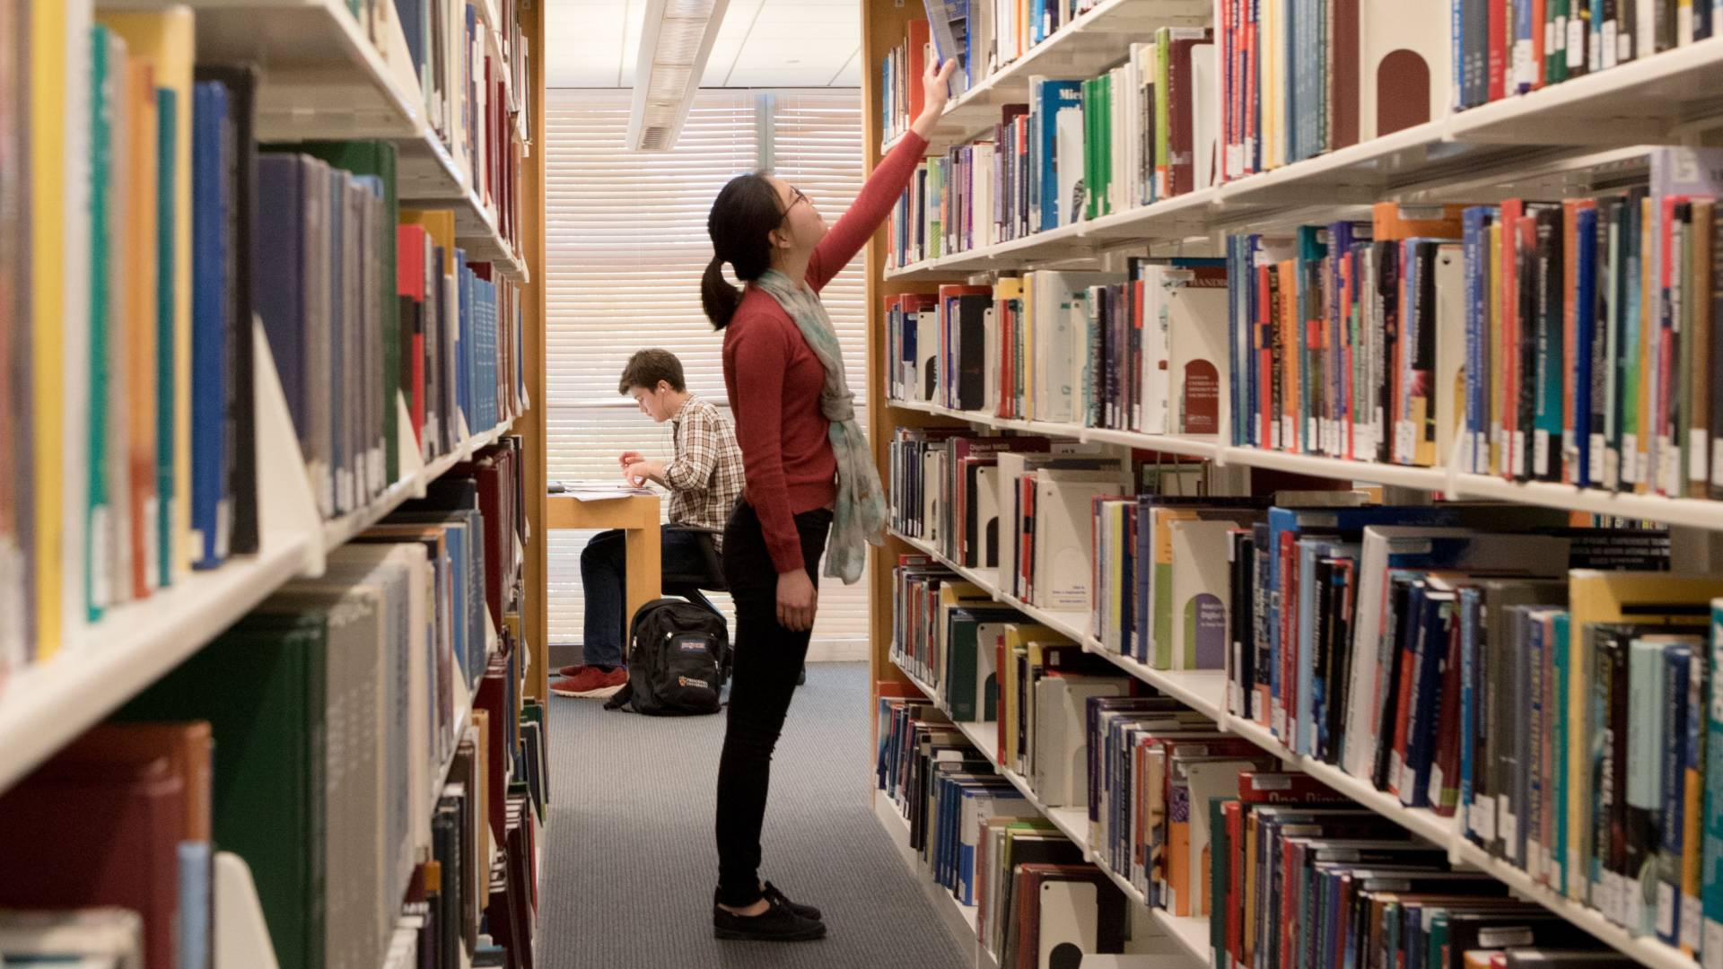
VOCABULARY
Places in town
library
/ˈlaɪbrəri/
a building in which collections of books, newspapers, etc. and sometimes films and recorded music are kept for people to read, study or borrow

Slide 23

VOCABULARY
Places in town
chemist’s
/ˈkemɪst/
a shop that sells medicines and usually also soap, make-up, etc.

Slide 24
Places in town
Videos
https://www.youtube.com/watch?v=EfD2k9beP-4

Slide 25

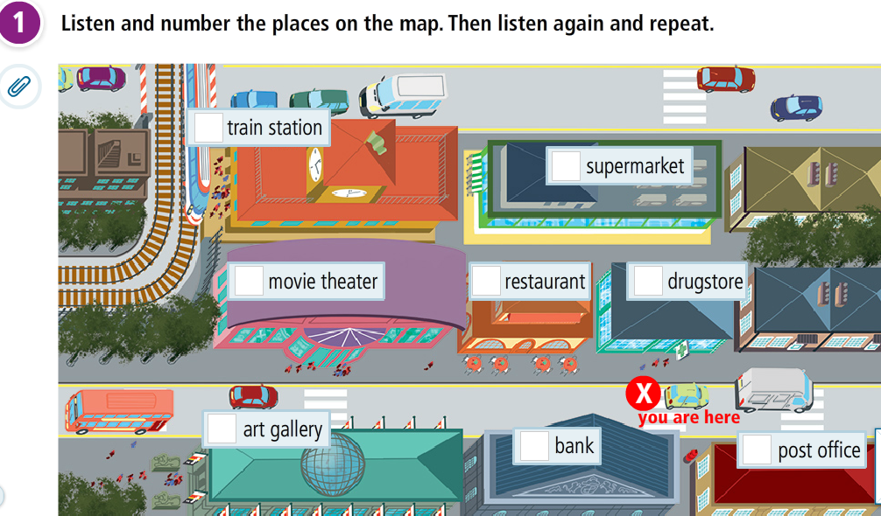
Where’s the bank?

Slide 26
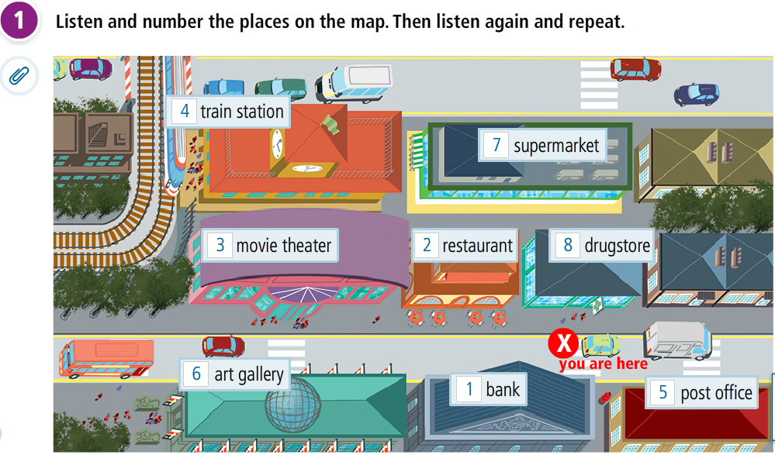
Where’s the bank?

Slide 27
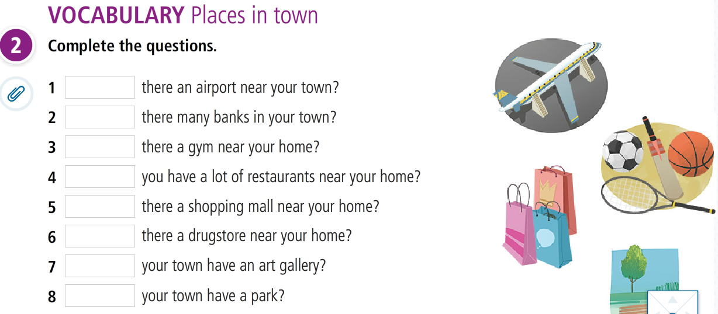
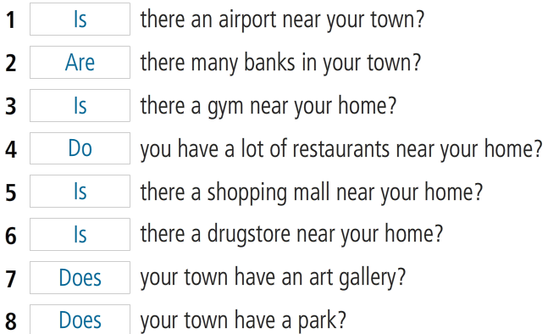
Where’s the bank?

Slide 28
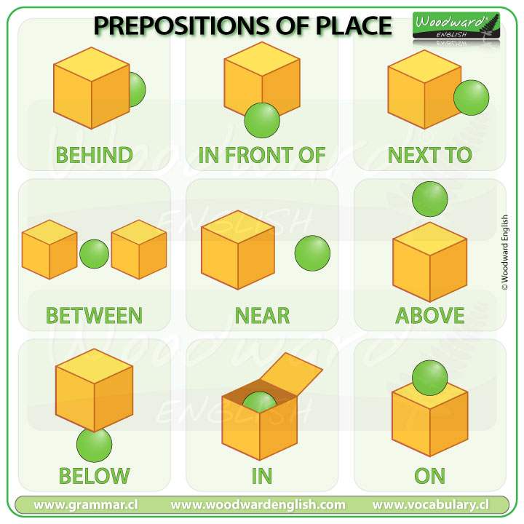

Slide 29
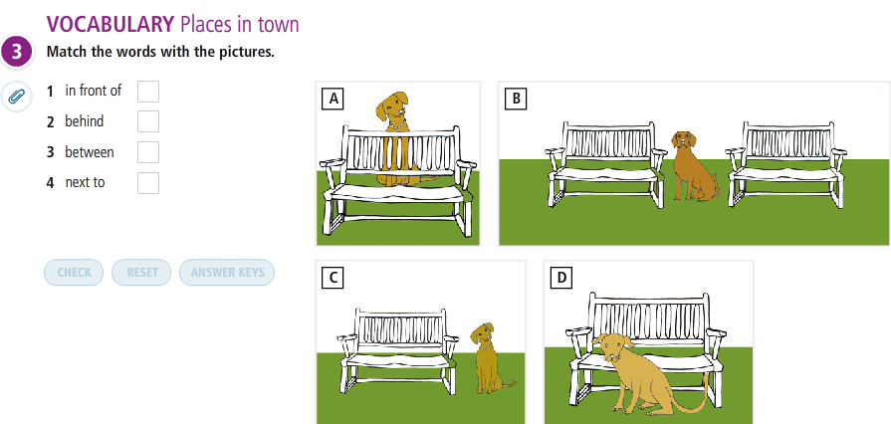
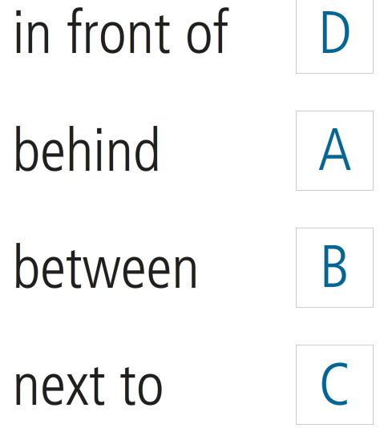
Prepositions of place

Slide 30
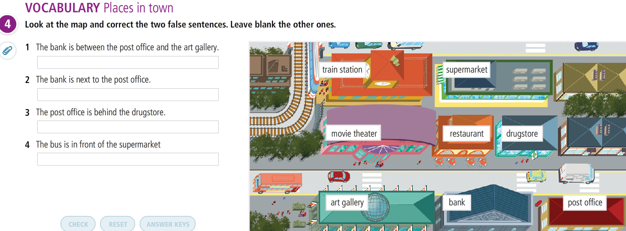
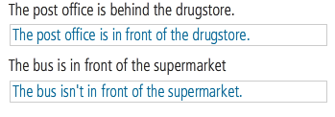

Slide 31
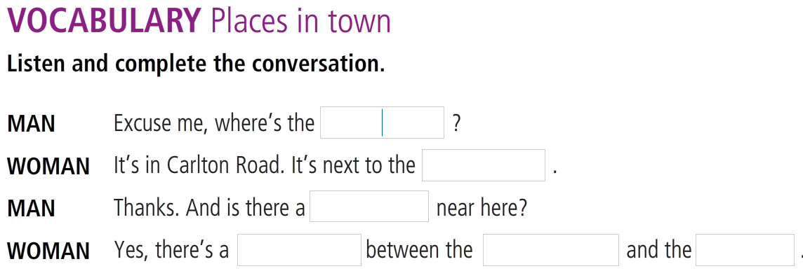
Lesson 3
Where’s the bank?

Slide 32
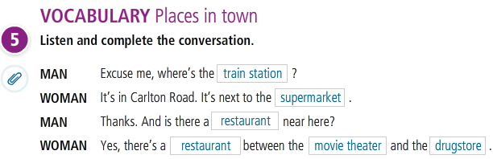
Lesson 3
Where’s the bank?

Slide 33
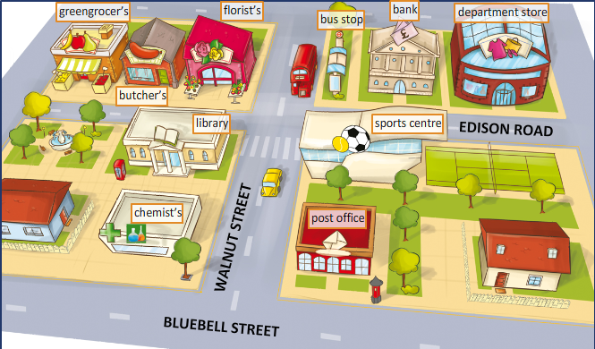
SPEAKING
Places in town
Pair work: Look at the map of the city and practice asking and answering bout the places.

Slide 34
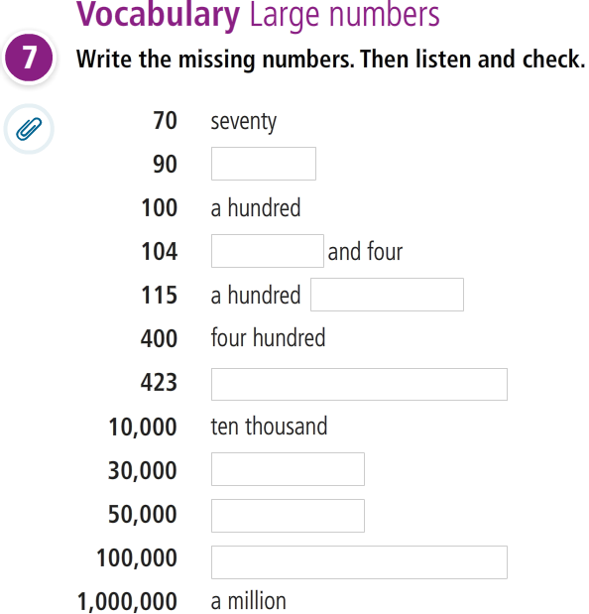

Slide 35
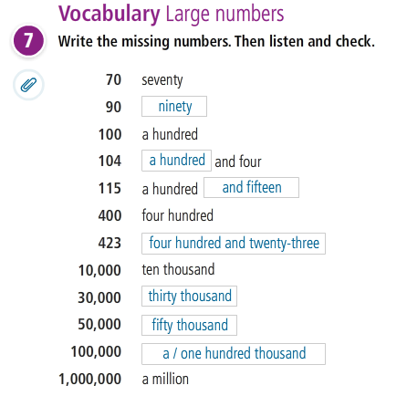

Slide 36
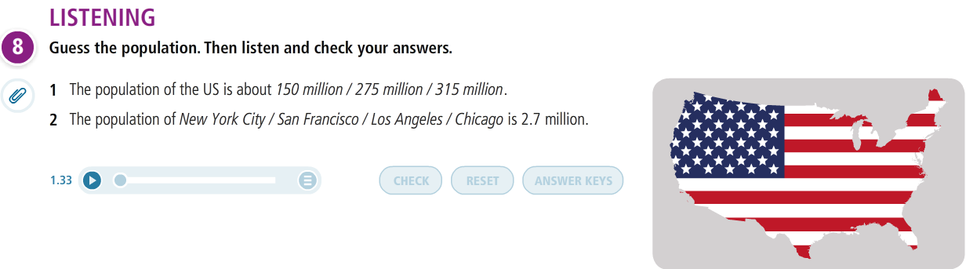
Lesson 3
Where’s the bank?

Slide 37
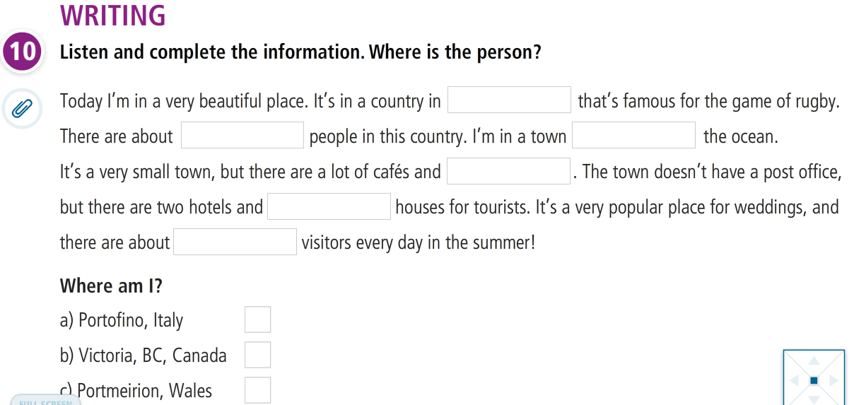
Lesson 3
Where’s the bank?

Slide 38
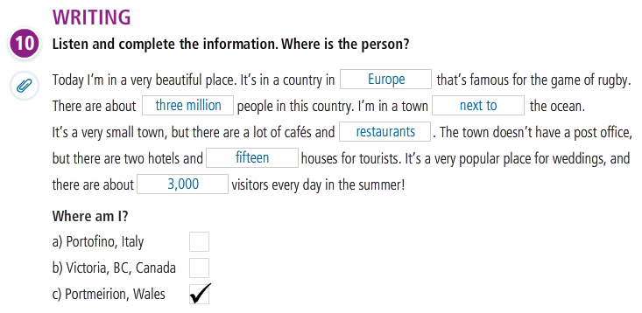

Slide 39


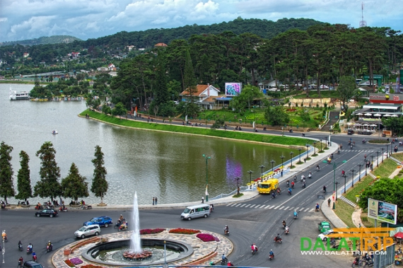
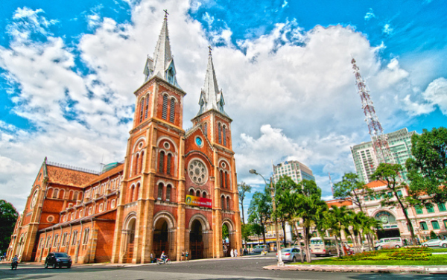
Writing practice
Write a description of your favorite place to visit. Use the information in exercise 10 to help you.

Slide 40
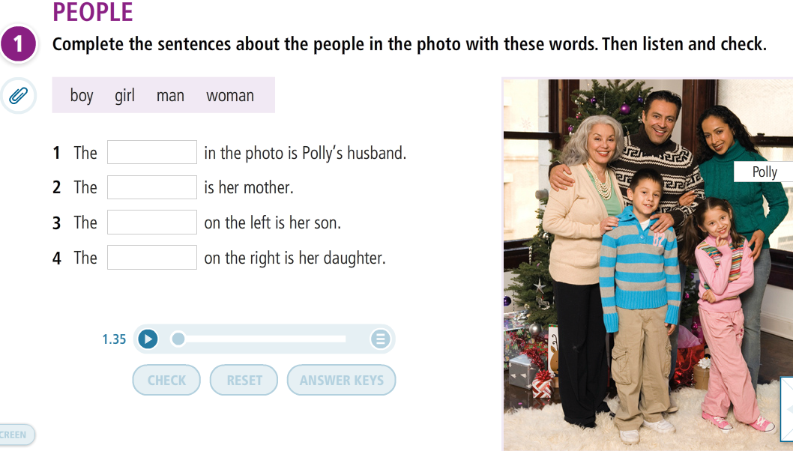
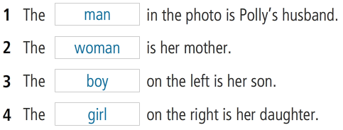
VOCABULARY PLUS

Slide 41
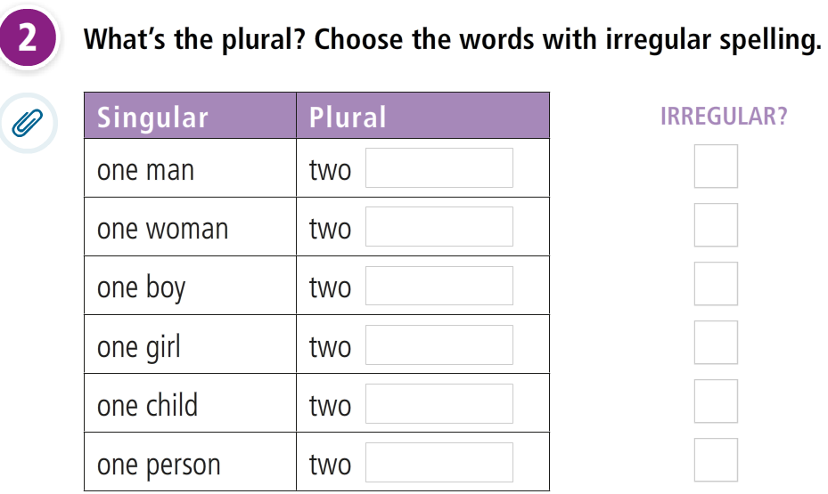
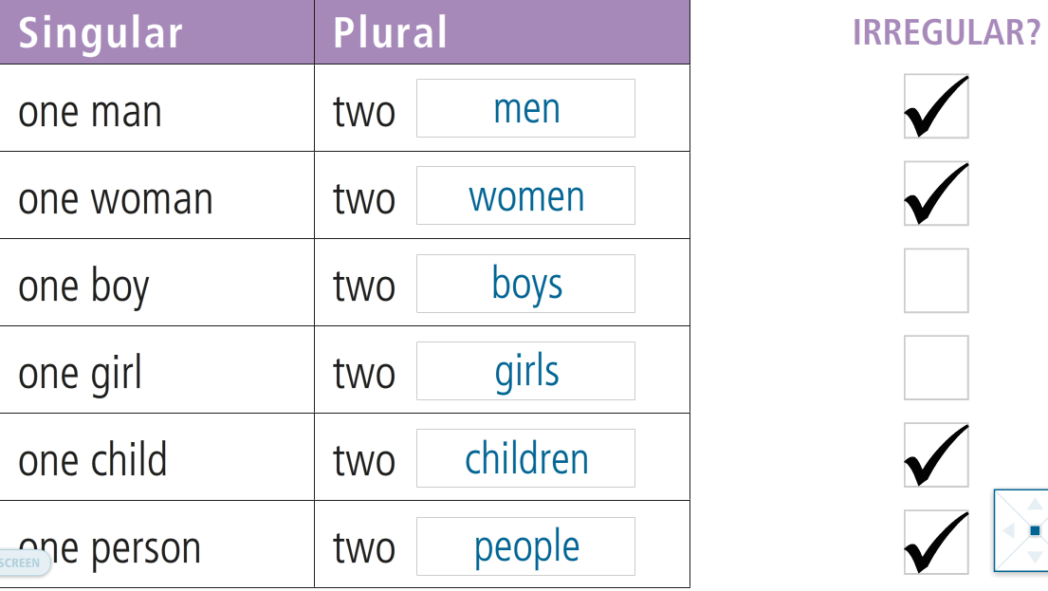
People

Slide 42
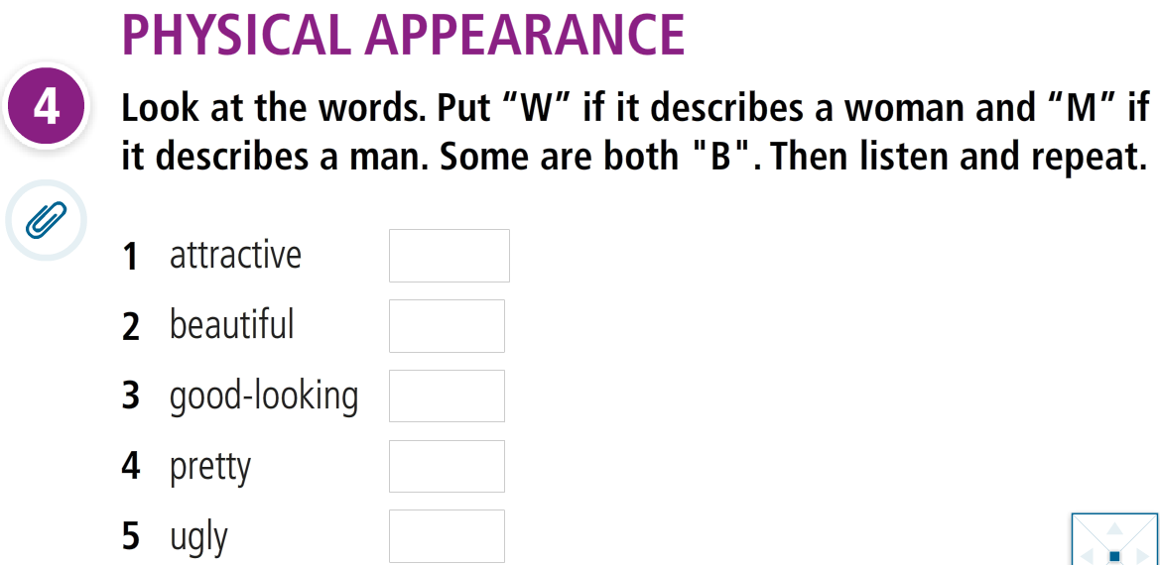
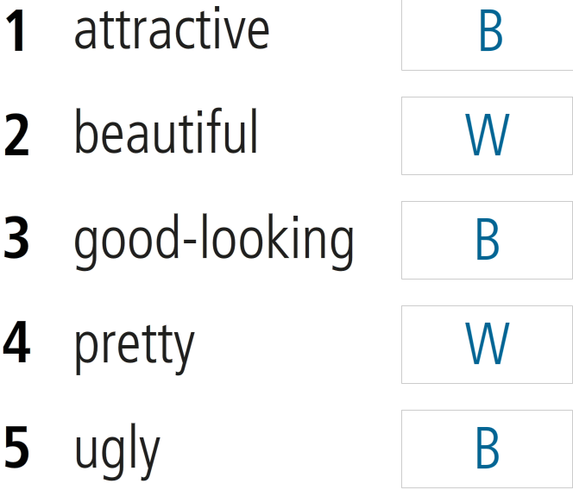
People

Slide 43
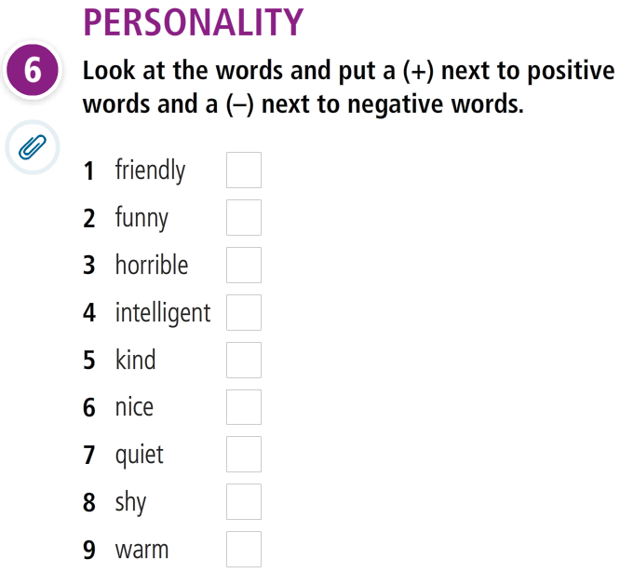
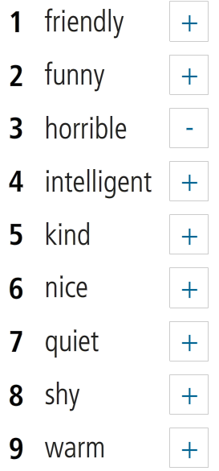
People

Slide 44

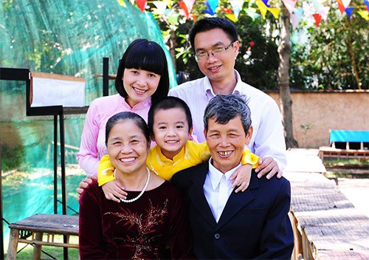
Speaking
Describe members of your family using the above words of personalities.
My sister isn’t beautiful, but she’s an attractive woman.
My mother is warm and friendly.

Slide 45
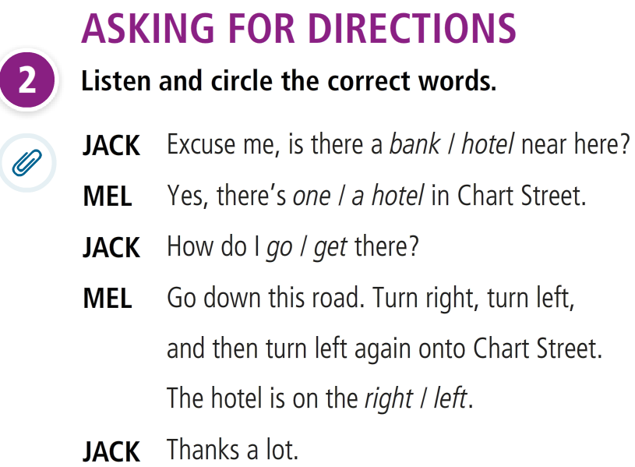
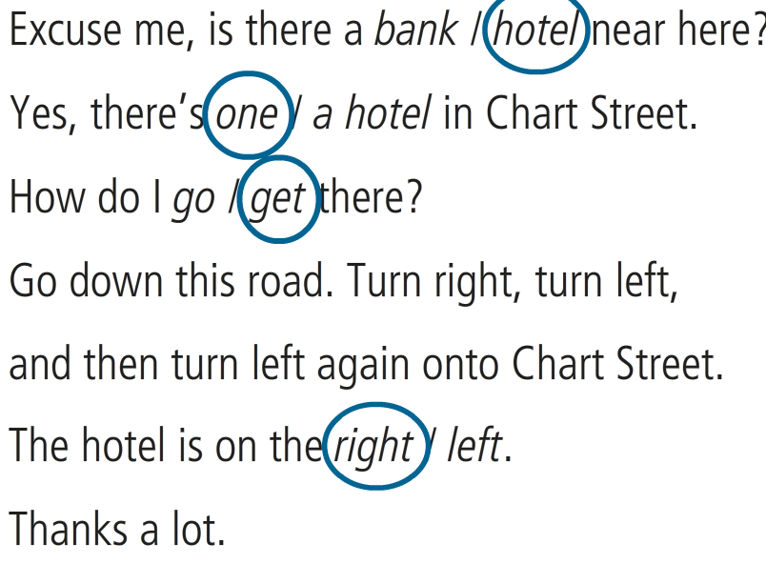
Language in action

Slide 46
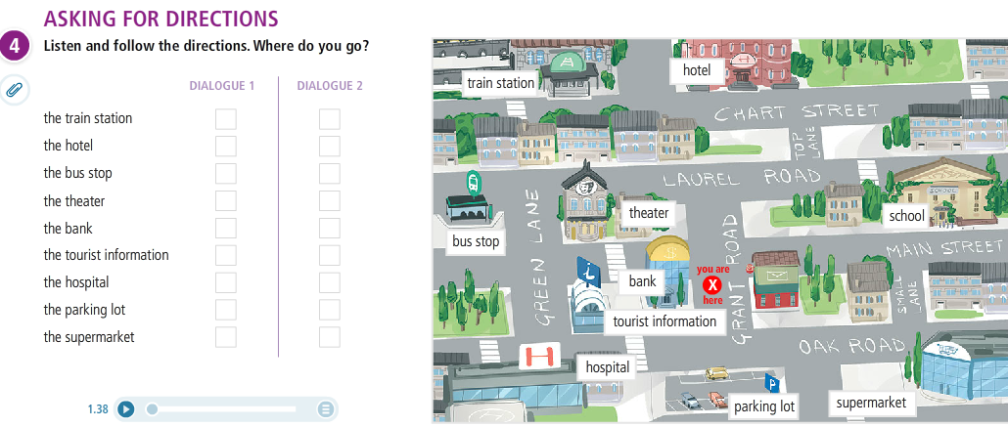
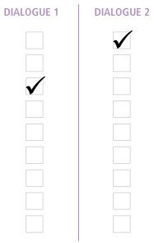
Language in action

Slide 47
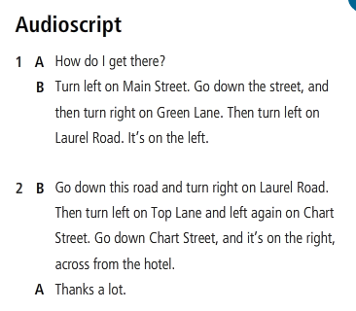
Language in action

Slide 48
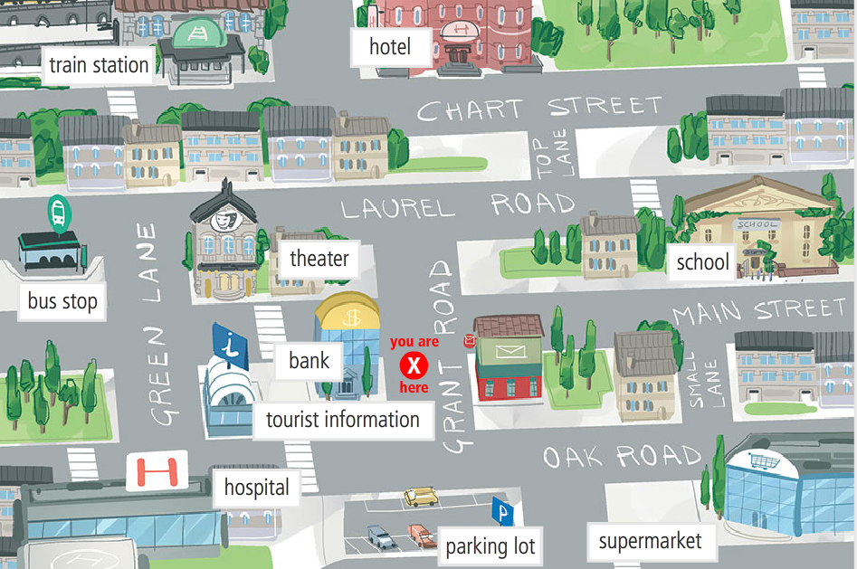
Language in action
Take turns to ask and give directions to places on the map.

Slide 49
Language in action
Further links for reference
https://www.youtube.com/watch?v=2JFqKRUB2vc
https://www.youtube.com/watch?v=-_YoeEY8FPM

Slide 50
The end!

